Slide 1
Preparing the firm’s information
SESSION 05
What does the firm hold, and what must happen before AI can use it reliably?
Jotham Martin Wambi KLAi Professional Learning
Notes:
Purpose: What does the firm hold, and what must happen before AI can use it reliably?
I will explain: I will ask: The instruction asks for exact quotes. What if the input scan loses a word? I will record the learner’s explanation before showing the answer. Good instructions cannot recover an unknown missing word reliably; inspect the source.
Ask: The instruction asks for exact quotes. What if the input scan loses a word?
Expected answer: Good instructions cannot recover an unknown missing word reliably; inspect the source.
If partly correct: Likely confusion: A PDF is necessarily searchable text. I will clarify: Compare the page image and encoded text, then inspect the observed OCR. Then return to this slide’s question: The instruction asks for exact quotes. What if the input scan loses a word? A supported answer should establish: Good instructions cannot recover an unknown missing word reliably; inspect the source.
Check evidence: identify the supplied source, the actual observed output and any gap before agreeing a conclusion.
Transition: Recall the task brief.
Teaching status: Essential sequence; use the session run-sheet.
Sources:
Fictional client matter; public authorities are identified separately. All required work happens in class.
Playback: Static slide. Discuss the complete visual; no click build is attached.

Slide 2
Recall the task brief
APPLIED AI AND AUTOMATION 05
RECALL SESSION 4
The instruction asks for exact quotes. What if the input scan loses a word?
TODAY’S QUESTION
What does the firm hold, and what must happen before AI can use it reliably?
Result: A source inventory and an inspected extraction with provenance.
KLAi Session 05 2
Notes:
Purpose: What does the firm hold, and what must happen before AI can use it reliably?
I will explain: Ask without showing the prior result. Good instructions cannot recover an unknown missing word reliably; inspect the source. Invite a reason, then connect the answer to today’s question.
Ask: The instruction asks for exact quotes. What if the input scan loses a word?
Expected answer: Good instructions cannot recover an unknown missing word reliably; inspect the source.
If partly correct: Likely confusion: OCR success means complete extraction. I will clarify: Check the negation, exception, layout and source location independently. Then return to this slide’s question: The instruction asks for exact quotes. What if the input scan loses a word? A supported answer should establish: Good instructions cannot recover an unknown missing word reliably; inspect the source.
Check evidence: identify the supplied source, the actual observed output and any gap before agreeing a conclusion.
Transition: The records room and the shared drive.
Teaching status: Essential sequence; use the session run-sheet.
Sources:
Fictional client matter; public authorities are identified separately. All required work happens in class.
Playback: Static slide. Discuss the complete visual; no click build is attached.

Slide 3
The records room and the shared drive
APPLIED AI AND AUTOMATION 05
Paper
Digital files
Systems
Files and scans
Agreements and email
DMS and accounting
These are source categories, not sequential stages. Inventory each source before choosing a preparation route.
KLAi Session 05 3
Notes:
Purpose: What does the firm hold, and what must happen before AI can use it reliably?
I will explain: Ask the learner to describe her actual information landscape verbally. Record systems and pain points during class. Do not assume the firm uses NetDocuments.
Ask: Where does important advice currently become difficult to find?
Expected answer: Use the learner’s answer to choose the inventory priority.
If partly correct: Likely confusion: Metadata is administrative only. I will clarify: Mis-tag a matter in discussion and ask which user might receive the wrong passage. Then return to this slide’s question: Where does important advice currently become difficult to find? A supported answer should establish: Use the learner’s answer to choose the inventory priority.
Check evidence: identify the supplied source, the actual observed output and any gap before agreeing a conclusion.
Transition: Four dimensions of information.
Teaching status: Essential sequence; use the session run-sheet.
Sources:
Fictional client matter; public authorities are identified separately. All required work happens in class.
Playback: Static slide. Discuss the complete visual; no click build is attached.

Slide 4
Four dimensions of information
APPLIED AI AND AUTOMATION 05
Dimension | Examples
Location or system | Records room, drive, NetDocuments, database
Modality | Text, document image, audio
Structure | Tabular, semi-structured, narrative
Format | DOCX, PDF, CSV, JSON, XML
KLAi Session 05 4
Notes:
Purpose: What does the firm hold, and what must happen before AI can use it reliably?
I will explain: Keep these axes distinct. NetDocuments is a system, PDF a format and image a modality. A spreadsheet can mix structured tables and unstructured notes.
Ask: Is a PDF necessarily machine-readable text?
Expected answer: No. It may contain selectable text, images or both.
If partly correct: Likely confusion: A PDF is necessarily searchable text. I will clarify: Compare the page image and encoded text, then inspect the observed OCR. Then return to this slide’s question: Is a PDF necessarily machine-readable text? A supported answer should establish: No. It may contain selectable text, images or both.
Check evidence: identify the supplied source, the actual observed output and any gap before agreeing a conclusion.
Transition: A searchable PDF and a page image.
Teaching status: Essential sequence; use the session run-sheet.
Sources:
Fictional client matter; public authorities are identified separately. All required work happens in class.
Playback: Static slide. Discuss the complete visual; no click build is attached.

Slide 5
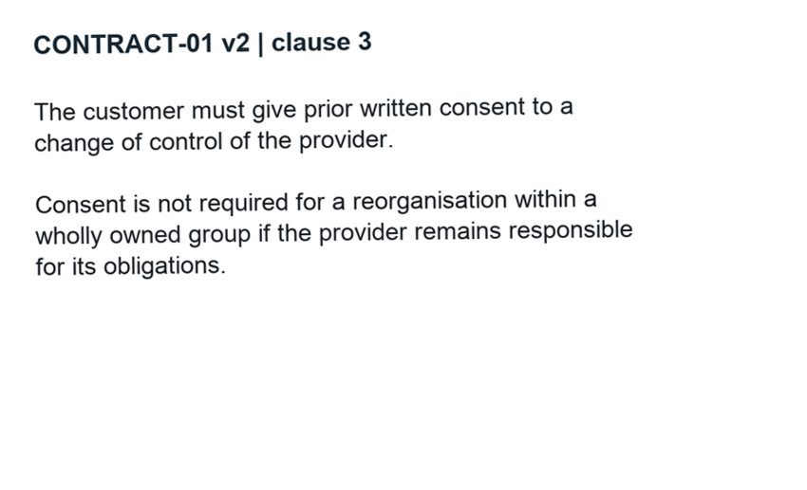
A searchable PDF and a page image
APPLIED AI AND AUTOMATION 05
EXTRACT AND VERIFY
Searchable text is useful only if the rule, negation, exception and condition survive.
Compare the observed OCR with the original page.
Synthetic scan of an authored source. A saved OCR run is separate from the deliberately damaged extract.
KLAi Session 05 5
Notes:
Purpose: What does the firm hold, and what must happen before AI can use it reliably?
I will explain: Show two representations of the same fictional clause. Search for responsible. A text layer helps but does not establish that extraction preserves meaning.
Ask: What does a successful text search fail to prove?
Expected answer: That every clause, table and reading-order relationship was captured.
If partly correct: Likely confusion: OCR success means complete extraction. I will clarify: Check the negation, exception, layout and source location independently. Then return to this slide’s question: What does a successful text search fail to prove? A supported answer should establish: That every clause, table and reading-order relationship was captured.
Check evidence: identify the supplied source, the actual observed output and any gap before agreeing a conclusion.
Transition: What the firm needs to know about each source.
Teaching status: Essential sequence; use the session run-sheet.
Sources:
Fictional client matter; public authorities are identified separately. All required work happens in class.
Playback: Static slide. Discuss the complete visual; no click build is attached.

Slide 6
What the firm needs to know about each source
APPLIED AI AND AUTOMATION 05
01
Matter and information owner
02
Authoritative version and effective date
03
Permitted readers and intended use
04
Update, retention and disposal responsibilities
KLAi Session 05 6
Notes:
Purpose: What does the firm hold, and what must happen before AI can use it reliably?
I will explain: Use the inventory CSV. Ask which source is executed, which is draft and which is a reference. Access is a design input, not an end-of-project setting.
Ask: Who should identify the authoritative agreement?
Expected answer: The matter owner or designated qualified person.
If partly correct: Likely confusion: Metadata is administrative only. I will clarify: Mis-tag a matter in discussion and ask which user might receive the wrong passage. Then return to this slide’s question: Who should identify the authoritative agreement? A supported answer should establish: The matter owner or designated qualified person.
Check evidence: identify the supplied source, the actual observed output and any gap before agreeing a conclusion.
Transition: A sample inventory.
Teaching status: Essential sequence; use the session run-sheet.
Sources:
Fictional client matter; public authorities are identified separately. All required work happens in class.
Playback: Static slide. Discuss the complete visual; no click build is attached.

Slide 7
A sample inventory
APPLIED AI AND AUTOMATION 05
Source | Role | Preparation
CONTRACT-01 v2 | Executed agreement | Extract and verify clauses
Draft v1 | Superseded context | Label and exclude from default answers
September ledger | Financial evidence | Check fields, period and units
Public judgment | Legal authority candidate | Check court, date and treatment
KLAi Session 05 7
Notes:
Purpose: What does the firm hold, and what must happen before AI can use it reliably?
I will explain: The status and role determine how a retrieval system should treat the source. The same filename in two folders can conceal different versions.
Ask: Would you delete the old draft immediately?
Expected answer: Follow the retention policy; keep provenance while controlling which version answers current questions.
If partly correct: Likely confusion: A PDF is necessarily searchable text. I will clarify: Compare the page image and encoded text, then inspect the observed OCR. Then return to this slide’s question: Would you delete the old draft immediately? A supported answer should establish: Follow the retention policy; keep provenance while controlling which version answers current questions.
Check evidence: identify the supplied source, the actual observed output and any gap before agreeing a conclusion.
Transition: The document preparation pipeline.
Teaching status: Essential sequence; use the session run-sheet.
Sources:
Fictional client matter; public authorities are identified separately. All required work happens in class.
Playback: Static slide. Discuss the complete visual; no click build is attached.

Slide 8
The document preparation pipeline
APPLIED AI AND AUTOMATION 05
01
02
03
04
Capture
Extract
Check
Represent
Scan or retrieve
Text and layout
Original against extract
Structure and metadata
KLAi Session 05 8
Notes:
Purpose: What does the firm hold, and what must happen before AI can use it reliably?
I will explain: This pipeline prepares content. Indexing and question-time retrieval follow in Session 6. Explain each transformation and the evidence that should survive it.
Ask: Which stage can change legal meaning?
Expected answer: Any faulty capture, extraction or transformation can omit or misassociate information.
If partly correct: Likely confusion: OCR success means complete extraction. I will clarify: Check the negation, exception, layout and source location independently. Then return to this slide’s question: Which stage can change legal meaning? A supported answer should establish: Any faulty capture, extraction or transformation can omit or misassociate information.
Check evidence: identify the supplied source, the actual observed output and any gap before agreeing a conclusion.
Transition: OCR and structured extraction.
Teaching status: Essential sequence; use the session run-sheet.
Sources:
Fictional client matter; public authorities are identified separately. All required work happens in class.
Playback: 4 native click reveals. Advance each stage and ask about the relationship it adds.

Slide 9
OCR and structured extraction
APPLIED AI AND AUTOMATION 05
01
Optical character recognition converts images of text into machine-readable text.
02
Layout analysis identifies document elements and their relationships.
03
Structured extraction maps selected content into defined fields.
KLAi Session 05 9
Notes:
Purpose: What does the firm hold, and what must happen before AI can use it reliably?
I will explain: Use the fictional source to distinguish characters, layout and extracted fields. A document-processing system can combine these mechanisms.
Ask: Would calling it OCR describe the entire pipeline?
Expected answer: No. OCR recognises text while layout, field extraction and validation address additional relationships.
If partly correct: Likely confusion: Metadata is administrative only. I will clarify: Mis-tag a matter in discussion and ask which user might receive the wrong passage. Then return to this slide’s question: Would calling it OCR describe the entire pipeline? A supported answer should establish: No. OCR recognises text while layout, field extraction and validation address additional relationships.
Check evidence: identify the supplied source, the actual observed output and any gap before agreeing a conclusion.
Transition: OCR and document layout.
Teaching status: Essential sequence; use the session run-sheet.
Sources: https://learn.microsoft.com/en-us/azure/ai-services/document-intelligence/prebuilt/layout?view=doc-intel-4.0.0
Fictional client matter; public authorities are identified separately. All required work happens in class.
Playback: Static slide. Discuss the complete visual; no click build is attached.

Slide 10
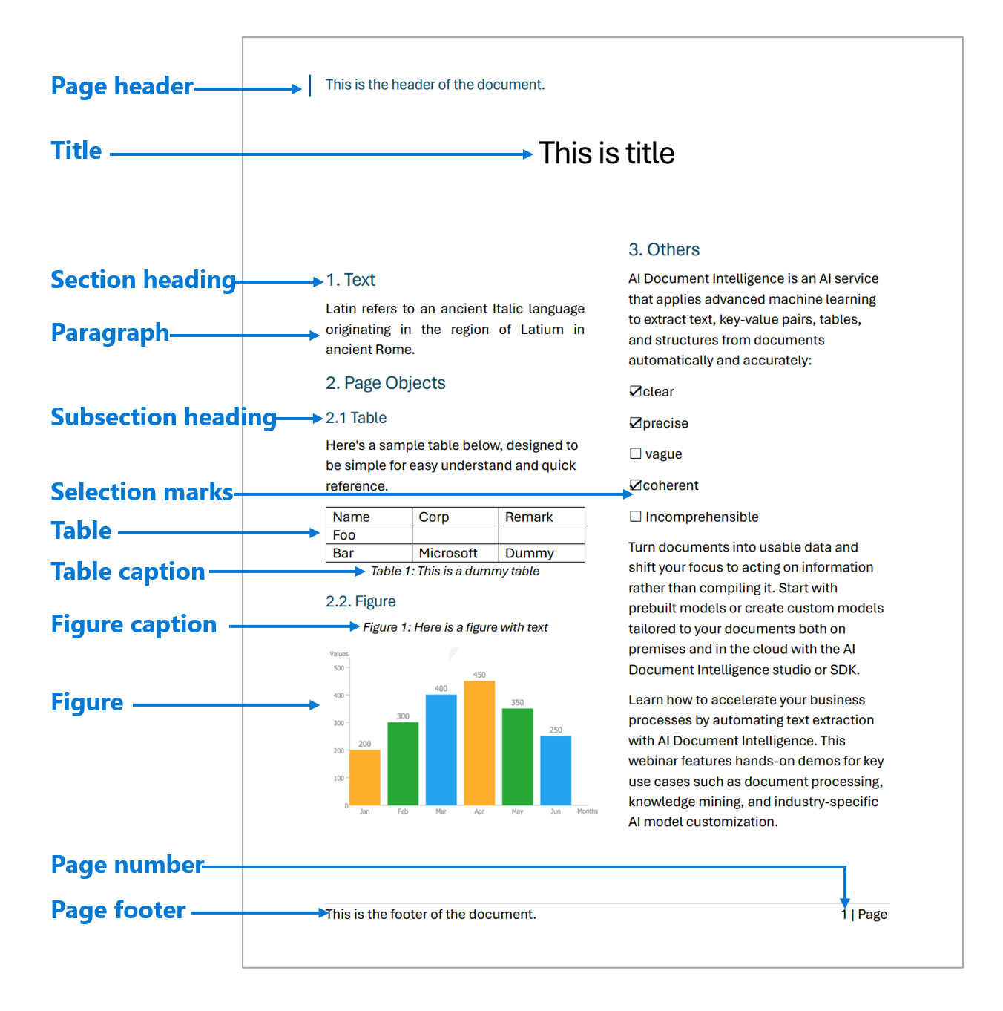
OCR and document layout
APPLIED AI AND AUTOMATION 05
Characters and words
OCR recovers readable text.
Layout and relationships
Headings, tables and reading order preserve context.
Microsoft Document Intelligence documentation example
KLAi Session 05 10
Notes:
Purpose: What does the firm hold, and what must happen before AI can use it reliably?
I will explain: Use the official Microsoft screenshot to show text blocks, sections and tables. OCR recognises characters; layout analysis recovers relationships such as headings and table cells. Interface images are reference material, not a class extraction run.
Ask: Why do tables need more than character recognition?
Expected answer: A number must remain associated with its row, column, unit and period.
If partly correct: Likely confusion: A PDF is necessarily searchable text. I will clarify: Compare the page image and encoded text, then inspect the observed OCR. Then return to this slide’s question: Why do tables need more than character recognition? A supported answer should establish: A number must remain associated with its row, column, unit and period.
Check evidence: identify the supplied source, the actual observed output and any gap before agreeing a conclusion.
Transition: An extraction error with legal consequences.
Teaching status: Essential sequence; use the session run-sheet.
Sources: https://learn.microsoft.com/en-us/azure/ai-services/document-intelligence/prebuilt/layout?view=doc-intel-4.0.0
Fictional client matter; public authorities are identified separately. All required work happens in class.
Playback: Static slide. Discuss the complete visual; no click build is attached.
Image attribution: Microsoft Document Intelligence documentation example
https://learn.microsoft.com/en-us/azure/ai-services/document-intelligence/prebuilt/layout?view=doc-intel-4.0.0

Slide 11
An extraction error with legal consequences
APPLIED AI AND AUTOMATION 05
Authoritative clause
Damaged extract
Consent is not required for a reorganisation within a wholly owned group if the provider remains responsible for its obligations.
Consent is required for a reorganisation within a wholly owned group.
KLAi Session 05 11
Notes:
Purpose: What does the firm hold, and what must happen before AI can use it reliably?
I will explain: The damaged extract drops not and the qualification. It is a deliberately prepared flawed example, not a measured OCR result. Ask the learner to identify both errors.
Ask: Could better prompting recover the missing original wording?
Expected answer: It cannot reliably reconstruct absent evidence. Re-extract or consult the original.
If partly correct: Likely confusion: OCR success means complete extraction. I will clarify: Check the negation, exception, layout and source location independently. Then return to this slide’s question: Could better prompting recover the missing original wording? A supported answer should establish: It cannot reliably reconstruct absent evidence. Re-extract or consult the original.
Check evidence: identify the supplied source, the actual observed output and any gap before agreeing a conclusion.
Transition: A source comparison on screen.
Teaching status: Essential sequence; use the session run-sheet.
Sources:
Fictional client matter; public authorities are identified separately. All required work happens in class.
Playback: Static slide. Discuss the complete visual; no click build is attached.

Slide 12

A source comparison on screen
APPLIED AI AND AUTOMATION 05
DAMAGED EXTRACT
Consent is required for a reorganisation within a wholly owned group.
Which wording disappeared?
Fictional class agreement rendered from the supplied source document
KLAi Session 05 12
Notes:
Purpose: What does the firm hold, and what must happen before AI can use it reliably?
I will explain: Show the rendered original fictional agreement page beside the prepared extract. Compare the heading, clause number, negation and exception. Preserve the page and clause reference in the extracted record.
Ask: Which checks should precede indexing?
Expected answer: Completeness, reading order, crucial wording and source locations.
If partly correct: Likely confusion: Metadata is administrative only. I will clarify: Mis-tag a matter in discussion and ask which user might receive the wrong passage. Then return to this slide’s question: Which checks should precede indexing? A supported answer should establish: Completeness, reading order, crucial wording and source locations.
Check evidence: identify the supplied source, the actual observed output and any gap before agreeing a conclusion.
Transition: A document quality record.
Teaching status: Essential sequence; use the session run-sheet.
Sources:
Fictional client matter; public authorities are identified separately. All required work happens in class.
Playback: Static slide. Discuss the complete visual; no click build is attached.
Image attribution: Fictional class agreement rendered from the supplied source document

Slide 13
A document quality record
APPLIED AI AND AUTOMATION 05
01
Preserve the original.
02
Record the defect and corrected version.
03
Retain the source location and reviewer.
04
Keep uncertain fields unresolved.
KLAi Session 05 13
Notes:
Purpose: What does the firm hold, and what must happen before AI can use it reliably?
I will explain: Use Document Quality Record.csv. A correction should not silently overwrite the only original. Ask whether OCR confidence alone can settle the legal consequence.
Ask: What happens to an unreadable amount?
Expected answer: Mark it unknown and obtain better evidence.
If partly correct: Likely confusion: A PDF is necessarily searchable text. I will clarify: Compare the page image and encoded text, then inspect the observed OCR. Then return to this slide’s question: What happens to an unreadable amount? A supported answer should establish: Mark it unknown and obtain better evidence.
Check evidence: identify the supplied source, the actual observed output and any gap before agreeing a conclusion.
Transition: Machine-readable representations.
Teaching status: Essential sequence; use the session run-sheet.
Sources:
Fictional client matter; public authorities are identified separately. All required work happens in class.
Playback: Static slide. Discuss the complete visual; no click build is attached.

Slide 14
Machine-readable representations
APPLIED AI AND AUTOMATION 05
Representation | Useful role
Markdown | Readable headings and document text
JSON | Named fields and structured outputs
Akoma Ntoso XML | Legal structure, identifiers and metadata
CSV or database table | Repeated financial or matter records
KLAi Session 05 14
Notes:
Purpose: What does the firm hold, and what must happen before AI can use it reliably?
I will explain: These formats solve different problems. A file conversion alone does not make the data reliable. No single format is compulsory for all AI systems.
Ask: Would every private contract need conversion to Akoma Ntoso?
Expected answer: No. Select a representation appropriate to the use and system.
If partly correct: Likely confusion: OCR success means complete extraction. I will clarify: Check the negation, exception, layout and source location independently. Then return to this slide’s question: Would every private contract need conversion to Akoma Ntoso? A supported answer should establish: No. Select a representation appropriate to the use and system.
Check evidence: identify the supplied source, the actual observed output and any gap before agreeing a conclusion.
Transition: One clause in structured form.
Teaching status: Essential sequence; use the session run-sheet.
Sources: https://docs.oasis-open.org/legaldocml/akn-core/v1.0/akn-core-v1.0-part1-vocabulary.html https://www.rfc-editor.org/rfc/rfc8259
Fictional client matter; public authorities are identified separately. All required work happens in class.
Playback: Static slide. Discuss the complete visual; no click build is attached.

Slide 15
One clause in structured form
APPLIED AI AND AUTOMATION 05
SOURCE
STRUCTURED RECORD
CONTRACT-01 v2
Clause 3
The customer must give prior written consent to a change of control of the provider. Consent is not required for a reorganisation within a wholly owned group if the provider remains responsible for its obligations.
{
"document_id": "CONTRACT-01",
"version": "v2",
"clause": "3",
"text": "Exact source passage",
"source_location": "clause 3"
}
JSON stores named fields: document_id is a key; CONTRACT-01 is its value. Text is abbreviated here.
KLAi Session 05 15
Notes:
Purpose: What does the firm hold, and what must happen before AI can use it reliably?
I will explain: JSON is a text format for structured data. A key names a field, and its value holds the information: document_id is the key and CONTRACT-01 is its value. Show the same clause as text and a small JSON object with document_id, version, clause, text and source_location. Quotes remain exact. The record provides fields a tool can check.
Ask: Which field prevents a quote becoming detached from its source?
Expected answer: The stable document identifier with version and source location.
If partly correct: Likely confusion: Metadata is administrative only. I will clarify: Mis-tag a matter in discussion and ask which user might receive the wrong passage. Then return to this slide’s question: Which field prevents a quote becoming detached from its source? A supported answer should establish: The stable document identifier with version and source location.
Check evidence: identify the supplied source, the actual observed output and any gap before agreeing a conclusion.
Transition: Permissions through the pipeline.
Teaching status: Essential sequence; use the session run-sheet.
Sources: https://www.rfc-editor.org/rfc/rfc8259
Fictional client matter; public authorities are identified separately. All required work happens in class.
Playback: Static slide. Discuss the complete visual; no click build is attached.

Slide 16
Permissions through the pipeline
APPLIED AI AND AUTOMATION 05
01
02
03
04
Source access
Copied content
Search results
Answer
Matter permissions
Carry restriction metadata
Filter for the user
Allowed evidence only
KLAi Session 05 16
Notes:
Purpose: What does the firm hold, and what must happen before AI can use it reliably?
I will explain: A copied index can become out of step with source access. Include access changes, deletion and withdrawn documents in operational tests.
Ask: What if a user loses access after indexing?
Expected answer: The retrieval and derived content must reflect the change before returning restricted evidence.
If partly correct: Likely confusion: A PDF is necessarily searchable text. I will clarify: Compare the page image and encoded text, then inspect the observed OCR. Then return to this slide’s question: What if a user loses access after indexing? A supported answer should establish: The retrieval and derived content must reflect the change before returning restricted evidence.
Check evidence: identify the supplied source, the actual observed output and any gap before agreeing a conclusion.
Transition: Our in-class work.
Teaching status: Essential sequence; use the session run-sheet.
Sources: https://learn.microsoft.com/en-us/azure/search/retrieval-augmented-generation-overview
Fictional client matter; public authorities are identified separately. All required work happens in class.
Playback: 4 native click reveals. Advance each stage and ask about the relationship it adds.

Slide 17
Our in-class work
APPLIED AI AND AUTOMATION 05
01
Inventory systems, formats, owners and access.
02
Compare the original, synthetic scan and observed OCR.
03
Mark omissions against the authoritative page.
04
Record corrections, provenance and update responsibilities.
We complete this together during class.
KLAi Session 05 17
Notes:
Purpose: What does the firm hold, and what must happen before AI can use it reliably?
I will explain: Use the run-sheet. I demonstrate the first example; the learner predicts, chooses evidence and checks the changed example. Save actual outputs or mark the step unexecuted.
Ask: Before we begin: Complete one inventory row per actual system discussed, without recording client identities.
Expected answer: A system, modality, structure and format describe different properties. Extraction must preserve the negation, exception and qualification. Preserve originals and source/access metadata through conversion.
If partly correct: Likely confusion: OCR success means complete extraction. I will clarify: Check the negation, exception, layout and source location independently. Then return to this slide’s question: Before we begin: Complete one inventory row per actual system discussed, without recording client identities. A supported answer should establish: A system, modality, structure and format describe different properties. Extraction must preserve the negation, exception and qualification. Preserve originals and source/access metadata through conversion.
Check evidence: identify the supplied source, the actual observed output and any gap before agreeing a conclusion.
Transition: What we can conclude.
Teaching status: Essential sequence; use the session run-sheet.
Sources:
Fictional client matter; public authorities are identified separately. All required work happens in class.
Playback: Static slide. Discuss the complete visual; no click build is attached.

Slide 18
What we can conclude
APPLIED AI AND AUTOMATION 05
01
A system, modality, structure and format describe different properties. Extraction must preserve the negation, exception and qualification. Preserve originals and source/access metadata through conversion.
02
A synthetic scan can test a method but does not establish extraction quality on the firm’s archive.
KLAi Session 05 18
Notes:
Purpose: What does the firm hold, and what must happen before AI can use it reliably?
I will explain: Have the learner explain the conclusion before I summarise it. Compare the actual result with the model answer and preserve unresolved questions.
Ask: Which part of today’s result remains unverified?
Expected answer: A synthetic scan can test a method but does not establish extraction quality on the firm’s archive.
If partly correct: Likely confusion: Metadata is administrative only. I will clarify: Mis-tag a matter in discussion and ask which user might receive the wrong passage. Then return to this slide’s question: Which part of today’s result remains unverified? A supported answer should establish: A synthetic scan can test a method but does not establish extraction quality on the firm’s archive.
Check evidence: identify the supplied source, the actual observed output and any gap before agreeing a conclusion.
Transition: The firm decision.
Teaching status: Essential sequence; use the session run-sheet.
Sources:
Fictional client matter; public authorities are identified separately. All required work happens in class.
Playback: Static slide. Discuss the complete visual; no click build is attached.

Slide 19
The firm decision
APPLIED AI AND AUTOMATION 05
01
Assign source owners and choose one collection for preparation before buying a search layer.
Record the decision and the evidence still needed.
KLAi Session 05 19
Notes:
Purpose: What does the firm hold, and what must happen before AI can use it reliably?
I will explain: Record a proposed owner and one condition before proceeding. This is a class decision record, not firm authorisation.
Ask: What evidence would change this proposed decision?
Expected answer: Assign source owners and choose one collection for preparation before buying a search layer. Revisit if the evidence, quality or permitted scope changes.
If partly correct: Likely confusion: A PDF is necessarily searchable text. I will clarify: Compare the page image and encoded text, then inspect the observed OCR. Then return to this slide’s question: What evidence would change this proposed decision? A supported answer should establish: Assign source owners and choose one collection for preparation before buying a search layer. Revisit if the evidence, quality or permitted scope changes.
Check evidence: identify the supplied source, the actual observed output and any gap before agreeing a conclusion.
Transition: Check understanding.
Teaching status: Essential sequence; use the session run-sheet.
Sources:
Fictional client matter; public authorities are identified separately. All required work happens in class.
Playback: Static slide. Discuss the complete visual; no click build is attached.

Slide 20
Check understanding
APPLIED AI AND AUTOMATION 05
01
The scan says shall not disclose; extraction says shall disclose. Which stage failed?
02
The text is accurate but the matter tag is wrong. What risk remains?
03
Which record preserves correction history?
KLAi Session 05 20
Notes:
Purpose: What does the firm hold, and what must happen before AI can use it reliably?
I will explain: Ask these changed-fact questions before opening the answer key. Extraction reversed meaning. Wrong metadata can expose or retrieve the wrong matter. Keep a source-linked quality/correction record and retest derived content.
Ask: A changed extraction
Expected answer: Extraction reversed meaning. Wrong metadata can expose or retrieve the wrong matter. Keep a source-linked quality/correction record and retest derived content.
If partly correct: Likely confusion: OCR success means complete extraction. I will clarify: Check the negation, exception, layout and source location independently. Then return to this slide’s question: A changed extraction A supported answer should establish: Extraction reversed meaning. Wrong metadata can expose or retrieve the wrong matter. Keep a source-linked quality/correction record and retest derived content.
Check evidence: identify the supplied source, the actual observed output and any gap before agreeing a conclusion.
Transition: Session 6: Internal knowledge search and retrieval.
Teaching status: Essential sequence; use the session run-sheet.
Sources:
Fictional client matter; public authorities are identified separately. All required work happens in class.
Playback: Static slide. Discuss the complete visual; no click build is attached.

Slide 21
Akoma Ntoso in legal publishing
APPLIED AI AND AUTOMATION 05
<section eId="sec_3">
<heading>Change of control</heading>
<content>
<p>Clause text with its qualification</p>
</content>
</section>
Illustrative structural fragment. It is not a complete, schema-validated Akoma Ntoso document.
KLAi Session 05 21 OPTIONAL EXPLORATION
Notes:
Purpose: What does the firm hold, and what must happen before AI can use it reliably?
I will explain: Show a short illustrative XML excerpt labelled as a teaching fragment, not a complete validated Akoma Ntoso document. Explain that legal publishing systems may provide structured originals.
Ask: When might structured legal XML be useful?
Expected answer: Maintaining legislation with sections, identifiers and versions across systems.
If partly correct: Likely confusion: Metadata is administrative only. I will clarify: Mis-tag a matter in discussion and ask which user might receive the wrong passage. Then return to this slide’s question: When might structured legal XML be useful? A supported answer should establish: Maintaining legislation with sections, identifiers and versions across systems.
Check evidence: identify the supplied source, the actual observed output and any gap before agreeing a conclusion.
Transition: Return to the essential session conclusion; explore this only if useful.
Teaching status: Optional exploration; not included in the 120-minute plan.
Sources: https://docs.oasis-open.org/legaldocml/akn-core/v1.0/akn-core-v1.0-part1-vocabulary.html
Fictional client matter; public authorities are identified separately. All required work happens in class.
Playback: Static slide. Discuss the complete visual; no click build is attached.

Slide 22
Financial data needs its own checks
APPLIED AI AND AUTOMATION 05
Field | Question
Amount and currency | UGX, another currency, or mixed units?
Period | Invoice date, service period or receipt date?
Missing value | Unknown, not applicable or zero?
Record identity | Genuine repeat or duplicate import?
KLAi Session 05 22 OPTIONAL EXPLORATION
Notes:
Purpose: What does the firm hold, and what must happen before AI can use it reliably?
I will explain: Open Invoice Import.csv and identify the repeated invoice. Do not clean records without understanding their meaning.
Ask: Should a missing fiscal document number (FDN) mean no sale occurred?
Expected answer: No. It identifies an evidence question rather than erasing the transaction.
If partly correct: Likely confusion: A PDF is necessarily searchable text. I will clarify: Compare the page image and encoded text, then inspect the observed OCR. Then return to this slide’s question: Should a missing fiscal document number (FDN) mean no sale occurred? A supported answer should establish: No. It identifies an evidence question rather than erasing the transaction.
Check evidence: identify the supplied source, the actual observed output and any gap before agreeing a conclusion.
Transition: Return to the essential session conclusion; explore this only if useful.
Teaching status: Optional exploration; not included in the 120-minute plan.
Sources:
Fictional client matter; public authorities are identified separately. All required work happens in class.
Playback: Static slide. Discuss the complete visual; no click build is attached.

Slide 23
Entities and document metadata
APPLIED AI AND AUTOMATION 05
01
Extract party names and dates from the text.
02
Retain document identity and version as metadata.
03
Resolve which legal entity a name actually denotes.
KLAi Session 05 23 OPTIONAL EXPLORATION
Notes:
Purpose: What does the firm hold, and what must happen before AI can use it reliably?
I will explain: NER identifies spans and categories. Entity resolution links references to the same entity. Obligation interpretation adds relationships and legal context. These are related but distinct tasks.
Ask: Do similar company names establish the same legal entity?
Expected answer: No. Check identifiers and authoritative records.
If partly correct: Likely confusion: OCR success means complete extraction. I will clarify: Check the negation, exception, layout and source location independently. Then return to this slide’s question: Do similar company names establish the same legal entity? A supported answer should establish: No. Check identifiers and authoritative records.
Check evidence: identify the supplied source, the actual observed output and any gap before agreeing a conclusion.
Transition: Return to the essential session conclusion; explore this only if useful.
Teaching status: Optional exploration; not included in the 120-minute plan.
Sources: https://learn.microsoft.com/en-us/azure/ai-services/language-service/named-entity-recognition/concepts/named-entity-categories
Fictional client matter; public authorities are identified separately. All required work happens in class.
Playback: Static slide. Discuss the complete visual; no click build is attached.

Slide 24
The inventory becomes an executive decision
APPLIED AI AND AUTOMATION 05
01
Which collection creates the greatest useful opportunity?
02
Who can establish its authority and quality?
03
What preparation and permission work is needed?
KLAi Session 05 24 OPTIONAL EXPLORATION
Notes:
Purpose: What does the firm hold, and what must happen before AI can use it reliably?
I will explain: The first task may be information management rather than buying a chatbot. Record a realistic owner and scope.
Ask: What would you fund first if most precedents are scans?
Expected answer: Inventory, source selection and reliable capture before a broad knowledge assistant.
If partly correct: Likely confusion: Metadata is administrative only. I will clarify: Mis-tag a matter in discussion and ask which user might receive the wrong passage. Then return to this slide’s question: What would you fund first if most precedents are scans? A supported answer should establish: Inventory, source selection and reliable capture before a broad knowledge assistant.
Check evidence: identify the supplied source, the actual observed output and any gap before agreeing a conclusion.
Transition: Return to the essential session conclusion; explore this only if useful.
Teaching status: Optional exploration; not included in the 120-minute plan.
Sources:
Fictional client matter; public authorities are identified separately. All required work happens in class.
Playback: Static slide. Discuss the complete visual; no click build is attached.

